Slide 1
CS209: Computer Science II

Slide 2
Unit 2 Module 2:
Templates
Function templates –
for Algorithm Abstraction
Defining Templates
Class Templates –
for Data Abstraction
Type deduction – a tangent

Slide 3
Function Templates
Function template: a pattern for a function that can work with many data types
When written, parameters are left for the data types
When called, compiler generates code for specific data types in function call

Slide 4
Function Template Example
template
prefix
template <class T>
T times10(T num)
{
return 10 * num;
}
generic
data type
type
parameter
What gets generated when times10 is called with an int: | What gets generated when times10 is called with a double:
int times10(int num) { return 10 * num; } | double times10(double num) { return 10 * num; }

Slide 5
Function Template
template<class T> is the template prefix
Tells compiler that the declaration or definition that follows is a template
Tells compiler that T is a type parameter
class means type in this context (typename could replace class but class is usually used)
T can be replaced by any type argument (whether the type is a class or not)
A template overloads the function name by replacing T with the type used in a function call

Slide 6
Function Template Example
template <class T>
T times10(T num)
{
return 10 * num;
}

Slide 7
Function Template Example
template <class T>
T times10(T num)
{
return 10 * num;
}
Call a template function in the usual manner:
int ival = 3;
double dval = 2.55;
cout << times10(ival); // displays 30
cout << times10(dval); // displays 25.5

Slide 8
Function Template Notes
Can define a template to use multiple data types:
template<class T1, class T2>
Example:
template<class T1, class T2> // T1 and T2 will be
double mpg(T1 miles, T2 gallons) // replaced in the
{ // called function
return miles / gallons // with the data
} // types of the
// arguments

Slide 9

Function Template Example
7 template<class T>
8 void swapValues(T& variable1, T& variable2)
9 {
10 T temp;
11 temp = variable1;
12 variable1 = variable2;
13 variable2 = temp;
14 }
15 int main( )
16 {
17 int integer1 = 1, integer2 = 2;
18 cout << "Original integer values are "
19 << integer1 << " " << integer2 << endl;
20 swapValues(integer1, integer2);
21 cout << "Swapped integer values are "
22 << integer1 << " " << integer2 << endl;
23 char symbol1 = 'A', symbol2 = 'B';
24 cout << "Original character values are: "
25 << symbol1 << " " << symbol2 << endl;
26 swapValues(symbol1, symbol2);
27 cout << "Swapped character values are: "
28 << symbol1

Slide 10
Function Template for a Swap
A generalized version of swap_values is shown here.
void swap_values(type_of_var &v1, type_of_var &v2) { type_of_var temp; temp = v1; v1 = v2; v2 = temp; }
This function, if type_of_var could accept any type, could be used to swap values of any type (as long as they are the same type)

Slide 11
Function Template Notes
Function templates can be overloaded Each template must have a unique parameter list
template <class T>
T sumAll(T num) ...
template <class T1, class T2>
T1 sumall(T1 num1, T2 num2) ...

Slide 12
Function Template Notes
All data types specified in template prefix must be used in template definition
Function calls must pass parameters for all data types specified in the template prefix
Like regular functions, function templates must be defined before being called

Slide 13
Function Template Notes
A function template is a pattern
template <typename T = int> struct myStruct {};
myStruct<double> funcA; // Explicitly specified myStruct<> funcB; // Default template
So any parameter, int, is used.

Slide 14
Function Template Notes
A function template is a pattern
No actual code is generated until the function named in the template is called
A function template uses no memory
When passing a class object to a function template, ensure that all operators in the template are defined or overloaded in the class definition

Slide 15
Algorithm Abstraction
Using a template function we can express more general algorithms in C++
Algorithm abstraction means expressing algorithms in a very general way so we can ignore incidental detail
This allows us to concentrate on the substantive part of the algorithm

Slide 16
Templates and Operators
The function index_of_smallest compares items in an array using the < operator
If a template function uses an operator, such as <, that operator must be defined for the types being compared
If a class type has the < operator overloaded for the class, then an array of objects of the class could be sorted with function template sort

Slide 17
Defining Templates
When defining a template it is a good idea…
To start with an ordinary function that accomplishes the task with one type
It is often easier to deal with a concrete case rather than the general case
Then debug the ordinary function
Next convert the function to a template by replacing type names with a type parameter

Slide 18
Inappropriate Types for Templates
Templates can be used for any type for which the code in the function makes sense
swap_values swaps individual objects of a type
This code would not work, because the assignment operator used in swap_values does not work with arrays:
int a[10], b[10]; <code to fill the arrays> swap_values(a, b);

Slide 19
Where to Start When Defining Templates
Templates are often appropriate for multiple functions that perform the same task with different parameter data types
Develop function using usual data types first, then convert to a template:
add template prefix
convert data type names in the function to a type parameter (i.e., a T type) in the template

Slide 20
Class Templates
Classes can also be represented by templates. When a class object is created, type information is supplied to define the type of data members of the class.
Unlike functions, classes are instantiated by supplying the type name (int, double, string, etc.) at object definition

Slide 21
Templates for Data Abstraction
Class definitions can also be made more general with templates
The syntax for class templates is basically the same as for function templates
template<class T> comes before the template definition
Type parameter T is used in the class definition just like any other type
Type parameter T can represent any type

Slide 22
Class Template Example
template <class T>
class grade
{
private:
T score;
public:
grade(T);
void setGrade(T);
T getGrade()
};

Slide 23
Class Template Example
Pass type information to class template when defining objects:
grade<int> testList[20];
grade<double> quizList[20];
grade<T>::grade(const T &myVar){
somedata = myVar;}
Use as ordinary objects once defined

Slide 24
Declaring Template Class Objects
Once the class template is defined, objects may be declared
Declarations must indicate what type is to be used for T
Example: To declare an object so it can hold a pair of integers: Pair<int> score;
or for a pair of characters: Pair<char> seats;

Slide 25
Using the Objects
After declaration, objects based on a template class are used just like any other objects
Continuing the previous example: score.set_element(1,3); score.set_element(2,0); seats.set_element(1, 'A');

Slide 26
Defining the Member Functions
Member functions of a template class are defined the same way as member functions of ordinary classes
The only difference is that the member function definitions are themselves templates

Slide 27
Defining set_element
Here is a definition for set_element in the template class Pair void Pair<T>::set_element(int position, T value) { if (position = = 1) first = value; else if (position = = 2) second = value; else … }

Slide 28
Defining a Pair Constructor
This is a definition of the constructor for class Pair that takes two arguments template<class T> Pair<T>::Pair(T first_value, T second_value) : first(first_value), second(second_value) { //No body needed due to initialization above }
The class name includes <T>

Slide 29
Template Class Names as Parameters
The name of a template class may be used as the type of a function parameter
Example: To create a parameter of type Pair<int>: int add_up(const Pair<int> &the_pair); //Returns the sum of two integers in the_pair

Slide 30
Template Functions with Template Class Parameters
Function add_up from a previous example can be made more general as a template function: template<class T> T add_up(const Pair<T> &the_pair) //Precondition: operator + is defined for T //Returns sum of the two values in the_pair

Slide 31
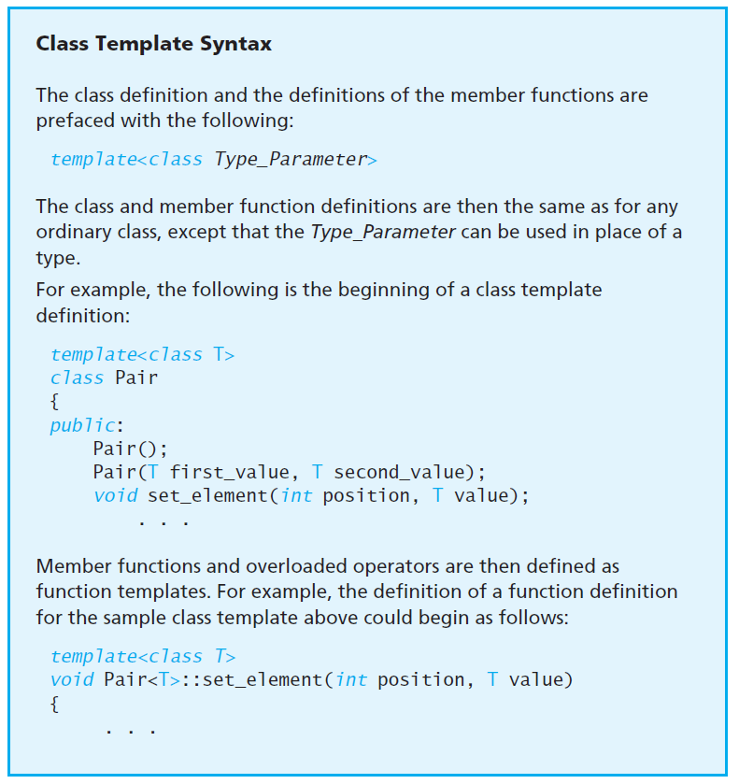

Slide 32
Templates and Declarations
A function template may also have a separate declaration
The template prefix and type parameter are used
Depending on your compiler
You may, or may not, be able to separate declaration and definitions of template functions just as you do with regular functions
To be safe, place template function definitions in the same file where they are used…with no declaration
A file included with #include is, in most cases, equivalent to being "in the same file“
This means including the .cpp file or .hpp file with implementation code

Slide 33
Templates and Declarations
Many compilers do not allow separate compilation of templates, so you may need to include your template definition with your code that uses it.
As usual, at least the function declaration must precede any use of the function template.
Some C++ compilers have additional special requirements for using templates.
If you have trouble compiling your templates, check your manuals or check with a local expert. You may need to set special options or rearrange the way you order the template definitions and the other items in your files.

Slide 34
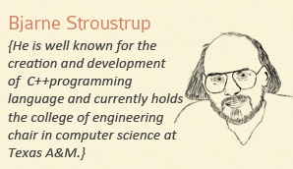
Templates and Declarations
A template is a “pattern” that the compiler uses to generate a family of classes or functions
For the compiler to generate the code, it must see both the template definition (not just declaration) and the specific types/whatever used to “fill in” the template.
Many compilers do not remember the details of one .cpp file while compiling another .cpp file.
Why? It’s just something that I haven’t fixed yet.
Test<int>

Slide 35
Templates and Efficiency
Templates are instantiated at compile time. A template instance has its parameters replaced by their actual values before it is compiled. This is the reason why there is virtually no cost to using templates

Slide 36
Templates and Efficiency
int Multiply (int x, int m)
{
return x * m;
}
template <int m>
int MultiplyBy (int x)
{
return x * m;
}
int a, b;
a = Multiply(10,8);
b = MultiplyBy<8>(10);

Slide 37
Templates and Efficiency
int Multiply (int x, int m)
{
return x * m;
}
int a, b;
a = Multiply(10,8);
runtime

Slide 38
Templates and Efficiency
template <int m>
int MultiplyBy (int x)
{
return x * m;
}
int a, b;
b = MultiplyBy<8>(10);
compile time
If MultiplyBy in this example is called with many different factors as template
parameters then the code can become very big.

Slide 39
Templates and Efficiency
int Multiply (int x, int m)
{
return x * m;
}
template <int m>
int MultiplyBy (int x)
{
return x * m;
}
int a, b;
a = Multiply(10,8);
b = MultiplyBy<8>(10);
In our example, the template function is faster because the compiler knows that it can multiply by a power of 2 by using a shift operation. x*8 is replaced by x<<3, which is faster. In the case of the regular function, the compiler doesn't know the value of m and therefore cannot do the optimization unless the function can be inlined.

Slide 40
Templates and Efficiency
Templates are efficient because the template parameters are always resolved at compile time. Templates make the source code more complex, but not the compiled code. In general, there is no cost in terms of execution speed to using templates.
Two or more template instances will be joined into one if the template parameters are exactly the same. If the template parameters differ then you will get one instance for each set of template parameters.

Slide 41
Templates and Efficiency
Excessive use of templates makes the code difficult to read.
A template with many instances makes the compiled code big and uses more cache space.

Slide 42

Journey to: The rabbit hole
"Ladies and gentlemen: the place you are about to go is not recommended, but staying awake and alert or sleeping restfully when we choose to depends largely on the function of a few small areas of the brain."

Slide 43
Understand template type deduction
The good news is that type deduction for templates is the basis for one of modern C++’s most compelling features: auto.
The bad news is that when the template type deduction rules are applied in the context of auto, they sometimes seem less intuitive than when they’re applied to templates.

Slide 44
Case 1: ParamType is a Reference or Pointer
template<typename T>
void funcA(ParamType param);
funcA(expr); // deduce T and ParamType from expr
This is the simplest situation. ParamType is a reference type or a pointer type.
In that case, type deduction works like this:
If expr’s type is a reference, ignore the reference part.
2. Then pattern-match expr’s type against ParamType to determine T.

Slide 45
Case 2: ParamType is a Forwarding Reference
If a variable or parameter is declared to have type T&& for some deduced type T, that variable or parameter is a forwarding reference.
Things are less obvious for templates taking forwarding reference parameters.
Such parameters are declared like rvalue references (i.e., in a function template taking a type parameter T, a forwarding reference’s declared type is T&&), but they behave differently when lvalue arguments are passed in.

Slide 46
What is a Forwarding Reference?
After V11, two successive (T&&) ampersands no longer mean just ‘logical and’ but they are also used to denote so-called rvalue references.
This overload forwards the argument to another function with the value category it had when passed to the calling function.
Perfect forwarding is often used with variadic templates to wrap calls to functions with an arbitrary number of arguments. For example, std::make_unique and std::make_shared both use perfect forwarding to forward their arguments to the constructor of the wrapped type.

Slide 47
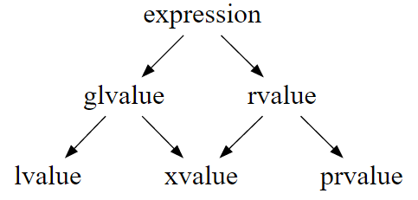
What is a Forwarding Reference?
Expressions are assigned a particular value category, based on the result of those expressions.
Value categories for expressions can affect C++ function overload resolution.

Slide 48
What is a Forwarding Reference?
An rvalue expression is any expression which can be implicitly moved from, regardless of whether it has identity.
rvalue expressions may be used as the argument to a function that takes a parameter of type T && (where T is the type of expr).
If a non-rvalue expression is used, then overload resolution will pick any function that does not use an rvalue reference parameter. And if none exist, then you get an error.

Slide 49
What is a Forwarding Reference?
A variadic template is template with at least one parameter pack.
A template parameter pack is a template parameter that accepts zero or more template arguments.
The formal definition of tangent is - a completely different line of thought or action.

Slide 50
On Forwarding Reference: Document #: N4164
Consider this code:
void funcA( X&& x );
template void funcB( Y&& y );
These parameters are fundamentally different.
What are the types of the function parameters?
What arguments do they accept or reject?
What is each parameter for?
Despite the syntactic similarity of X&& and Y&&, the answers are fundamentally different for funcA and funcB.

Slide 51
On Forwarding Reference: Document #: N4164
void funcA( X&& x );
template void funcB( Y&& y );
What are the types of the function parameters?
funcA takes an rvalue reference to non-const. funcB takes an lvalue or rvalue reference to everything.

Slide 52
On Forwarding Reference: Document #: N4164
void funcA( X&& x );
template void funcB( Y&& y );
What arguments do they accept or reject?
funcA accepts only rvalue X objects. funcB accepts all Y objects.

Slide 53
On Forwarding Reference: Document #: N4164
void funcA( X&& x );
template void funcB( Y&& y );
What is each parameter for?
funcA’s parameter is for capturing temporaries (and other rvalues). funcB’s parameter is for forwarding its argument onward.
The last point gets to the heart of the matter: The current T&& design was specifically designed to support argument forwarding uses.

Slide 54
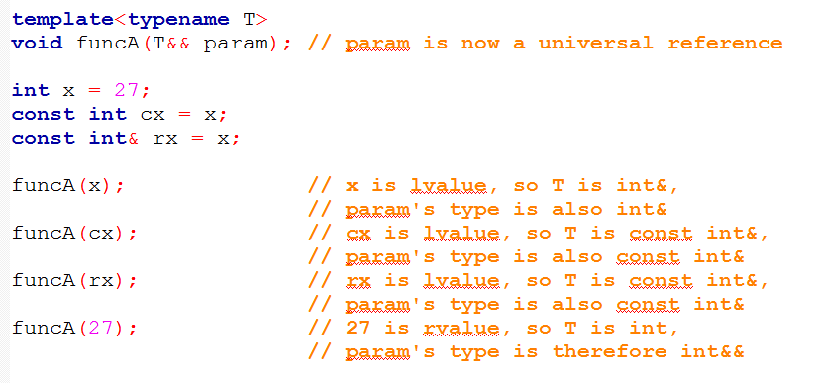
Case 2: ParamType is a Forwarding Reference

Slide 55
Case 3: ParamType is not a Pointer or Reference
When ParamType is neither a pointer nor a reference, we’re dealing with pass-by-value.
That means that param will be a copy of whatever is passed in—a completely new object. The fact that param will be a new object motivates the rules that govern how T is deduced from expr:
1. As before, if expr’s type is a reference, ignore the reference part.
2. If, after ignoring expr’s reference-ness, expr is const, ignore that, too.

Slide 56
Understand template type deduction
During template type deduction, arguments that are references are treated as non-references, i.e., their reference-ness is ignored.
When deducing types for universal reference parameters, lvalue arguments get special treatment.
When deducing types for by-value parameters, const and/or volatile arguments are treated as non-const and non-volatile.
During template type deduction, arguments that are array or function names decay to pointers, unless they’re used to initialize references.

Slide 57
I see a definite pattern emerging with templates.

Slide 58
References
Slide contributions include:
Walter Savitch, Problem solving with C++ (9th Edition). Addison-Wesley Longman Publishing Co., Inc. Boston, MA, USA ©2015
Gaddis, Starting Out with C++: From Control Structures through Objects, (8th Ed.) , Addison-Wesley Longman Publishing Co., Inc. Boston, MA, USA ©2015
Bjarne Stroustrup, The C++ Programming Language, 3rd Edition, Addison-Wesley Longman Publishing Co., Inc. Boston, MA, USA ©2007
Herb Sutter, Andrei Alexandrescu, C++ coding standards : 101 rules, guidelines, and best practices, Copyright © 2005 Pearson Education, Inc.
Paul Deitel & Harvey Deitel, C++ How to Program, (7th Ed.) © 2010 by Pearson Education, Inc.
Upper Saddle River, New Jersey 07458
Scott Meyers, Effective Modern C++. Copyright © 2015 (O’Reilly) , 978-1-491-90399-5.
Andrew Koenig and Barbara E. Moo, Accelerated C++ Practical Programming by Example,
Addison-Wesley, 2000 ISBN 0-201-70353-X

Slide 59
References
Slide contributions include:
Frank M. Carrano. Data Abstraction & Problem Solving with C++ (5th Edition)
Addison-Wesley Longman Publishing Co., Inc. Boston, MA, USA ©2006
TutorialsPoint - http://www.tutorialspoint.com/cplusplus/
Cplusplus.com - http://www.cplusplus.com/doc/tutorial/

